Slide 1
Neural Subgraph Retrieval
LORENZO BALZANI
BOLOGNA, 10/05/2024

Slide 2
Agenda
1. Task definition
Task overview
Data overview
2. Inspiration architecture
Zhang et al. “Subgraph retrieval enhanced model for multi-hop knowledge base question answering”
3. My solution
Next relation predictor
Shortest paths dataset
Link predictor
Term normalization
End-to-end model
4. Code overview
Tech stack
Let’s look at the code!
5. Conclusion
Limitations & what’s next
6. Q&A

Slide 3
Task definition

Slide 4
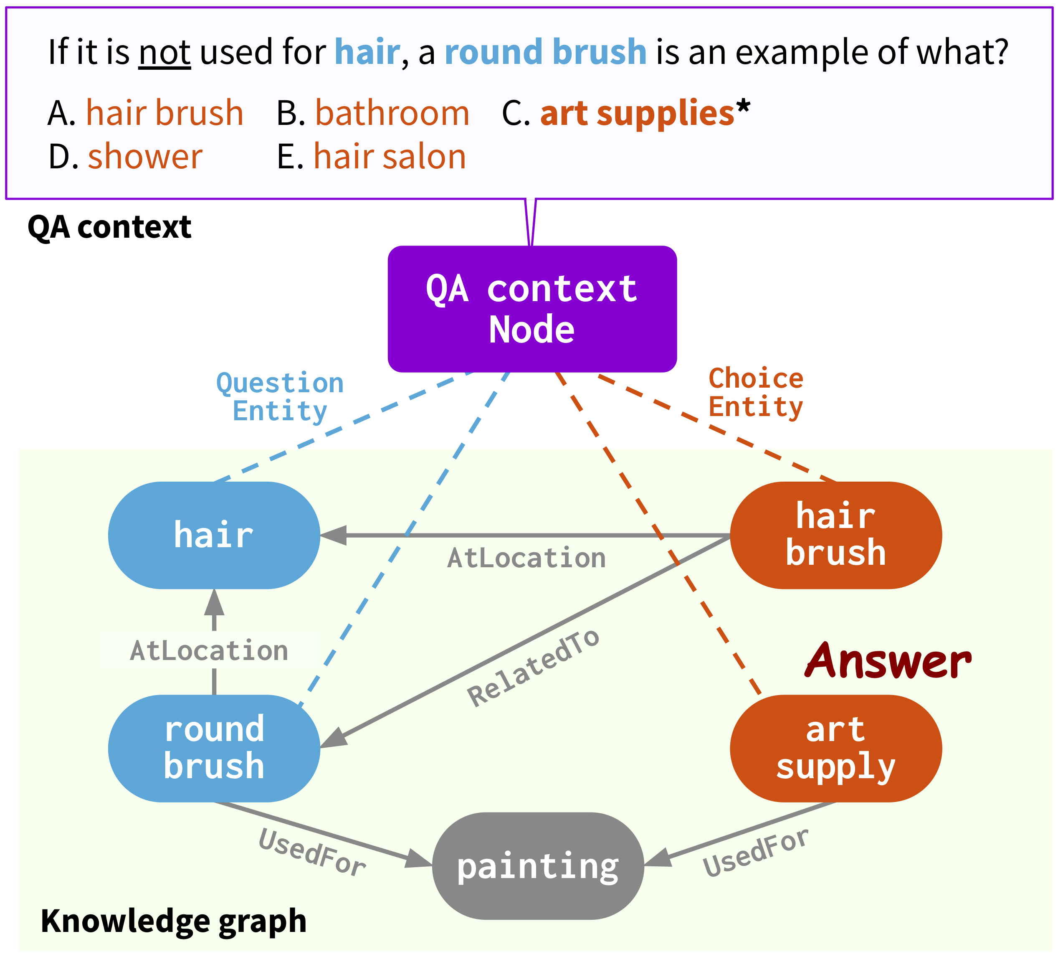
Task overview
What do we want to achieve?
The goal: extract the best possible subgraph from the UMLS (Unified Medical Language System) Knowledge Graph to tackle the task of open-book question answering in the biomedical domain.
Open-book approach: the system can access external knowledge during the inference process, assuming it not relying solely on its internal knowledge, i.e. closed book (updated weights during pre-training and fine-tuning).
Data: the reference dataset is MedQA.
Subsequent reasoning: once a subgraph is extracted, a subsequent system can reason upon it and correctly answer to the question, e.g. using the solution presented in “QA-GNN: Reasoning with Language Models and Knowledge Graphs for Question Answering” by the Stanford University.
Scope: this project focuses just on the subgraph extraction phase.
How QA-GNN handles the reasoning process.

Slide 5
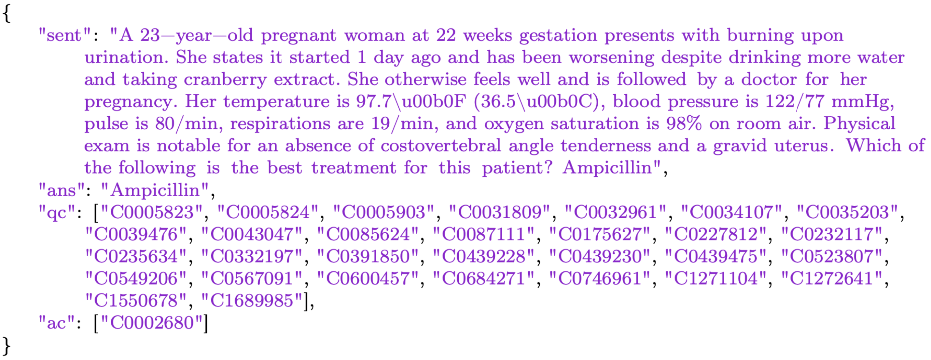
Data overview
MedQA dataset
It’s a multiple-choice question answering dataset based on the United States Medical License Exams (USMLE) and it’s collected from the professional medical board exams.
Each instance is composed by the following keys:
sent: represents the question
qc: is a list of identifiers of the topic entities, i.e. the entities present in the question
ans: represents the response entity label
ac: represents the response entity identifier in the UMLS knowledge graph
First instance of the MedQA dataset.

Slide 6
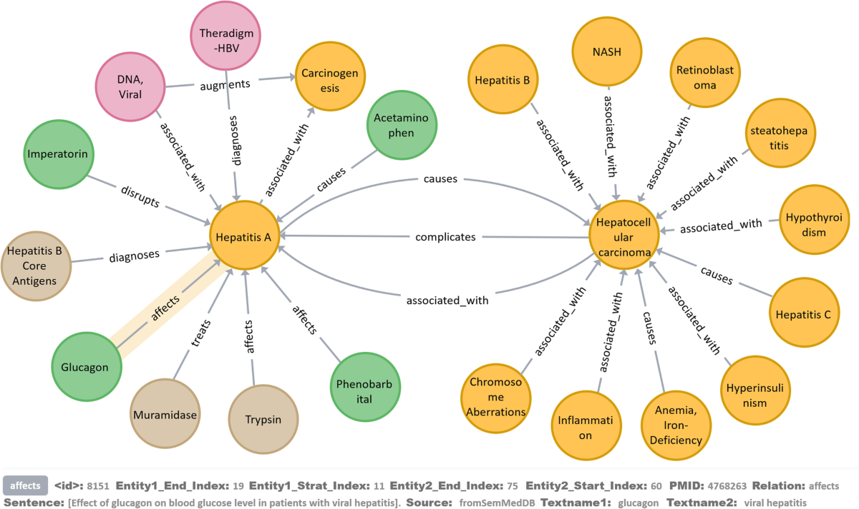
Data overview – ii
UMLS KG
The Unified Medical Language System (UMLS) is a knowledge graph developed and maintained by the National Library of Medicine (NLM) in the United States.
It's a comprehensive set of biomedical concepts, terms, and relationships that enables interoperability among different biomedical and health-related information systems and applications.
It provides a standardized framework for mapping and linking different terminologies and concepts.
Subset of nodes/edges of the UMLS KG

Slide 7
Inspiration architecture

Slide 8
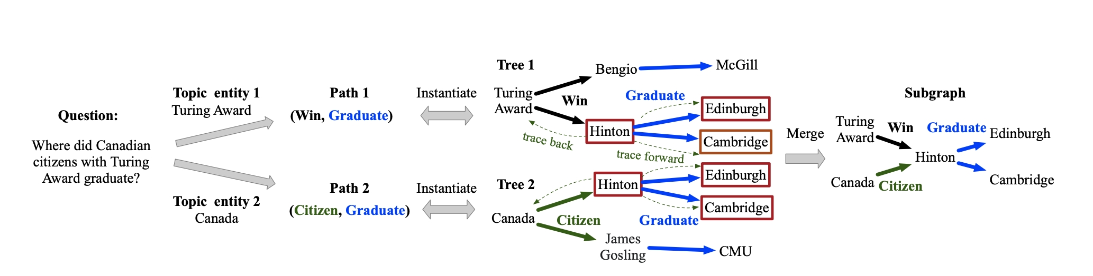
Subgraph retrieval enhanced model for multi-hop knowledge base question answering
From Zhang et. al
The researchers propose a trainable subgraph retriever (SR) decoupled from the subsequent reasoning process, which enables a plug-and-play framework to enhance any subgraph-oriented KBQA model.
Their work is benchmarked on two datasets:
WebQuestions Semantic Parses Dataset, contains full semantic parses in SPARQL queries for about 5k questions.
ComplexWebQuestion Dataset, for answering complex questions that require reasoning over multiple web snippets.
In the example on top, we can see that the following two tasks are defined and disjoint (i.e. they are tackled with separated architectures):
Given the relations traversed in the graph so far, predict the next one.
We instantiate the found paths and take only the common nodes.

Slide 9
My solution

Slide 10
Next relation prediction
Where direction should we follow now?
Why is it a good idea to use BioLinkBERT?
NRP (i.e. next relation prediction), given the relations traversed so far in a graph, we aim to answer which relation follow next. We use BioLinkBERT to tackle this task.
Transformer encoder (BERT-like) model that improves its cross-document multi-hop reasoning skills. It captures document links such as hyperlinks and citation links to include knowledge that spans across multiple documents.
Pre-trained by feeding linked documents into the same language model context, besides a single document, substituting the next sentence prediction task, forcing the model reasoning to be multi-hop.
Effective for knowledge-intensive tasks (e.g. question answering) and cross-document tasks (e.g. reading comprehension, document retrieval) in the biomedical domain.
How should we fine-tune the model?
Since we don’t have a dataset made up of the GOLD paths between topic entities and answers to train the NRP on, we should create it:
It’s impossible to effectively create a dataset that contains the best path to achieve an answer given a question.
Thus, we introduce a strong optimistic assumption with a heuristic: the best path is the shortest one.
I executed the fine-tuning on a custom dataset crafted starting by the UMLS subset introduced in “QA-GNN”.

Slide 11
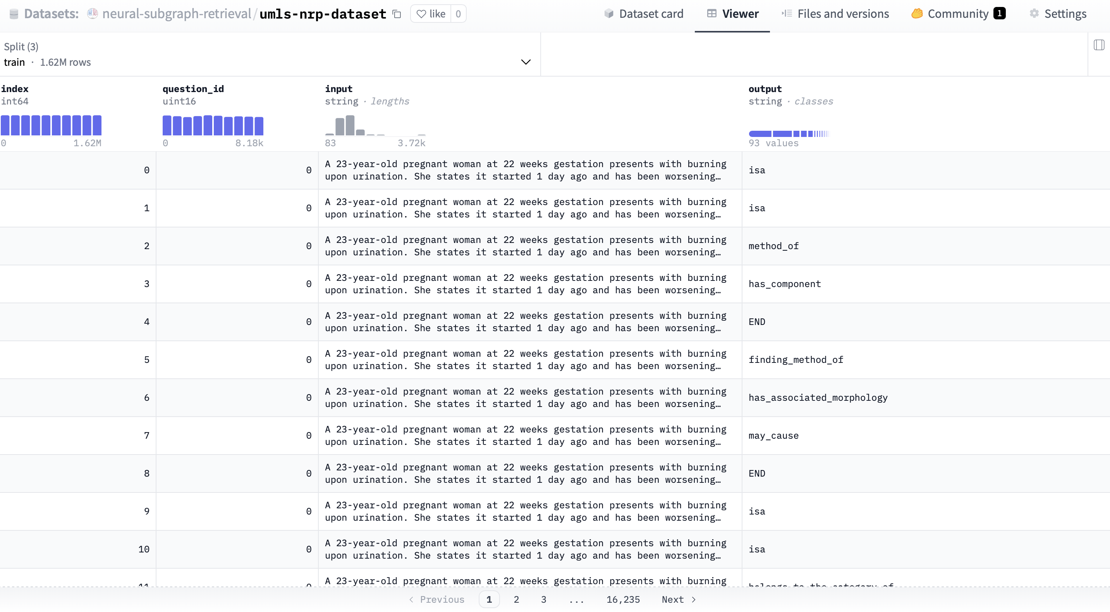
Shortest paths dataset
Teaching the model how to traverse the UMLS KG

Slide 12
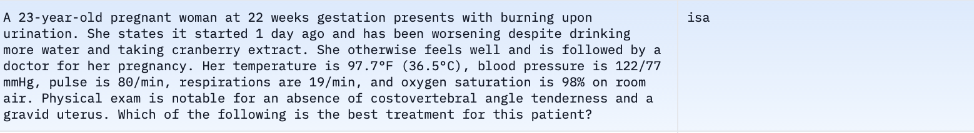
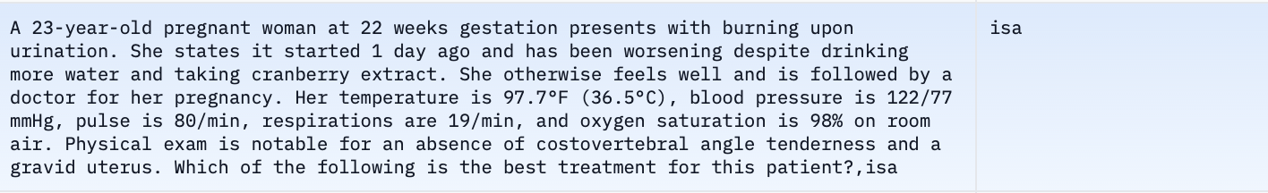
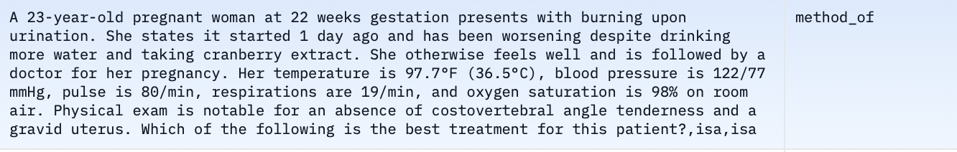
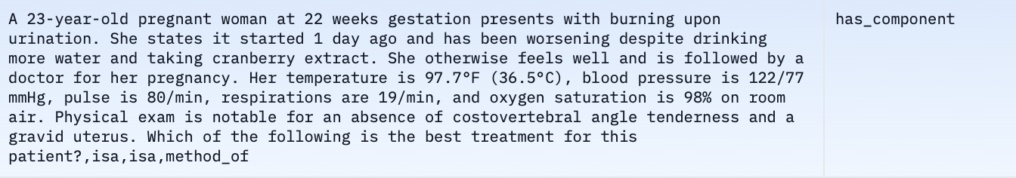
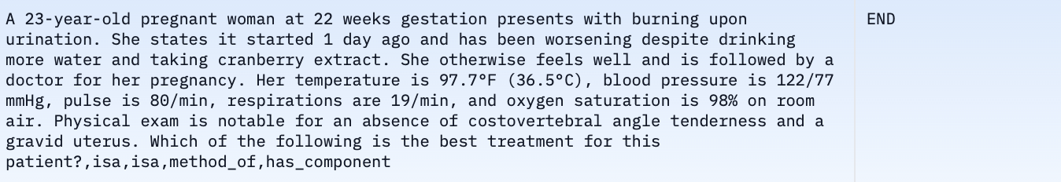
Shortest paths dataset – ii
A question end-to-end example

Slide 13
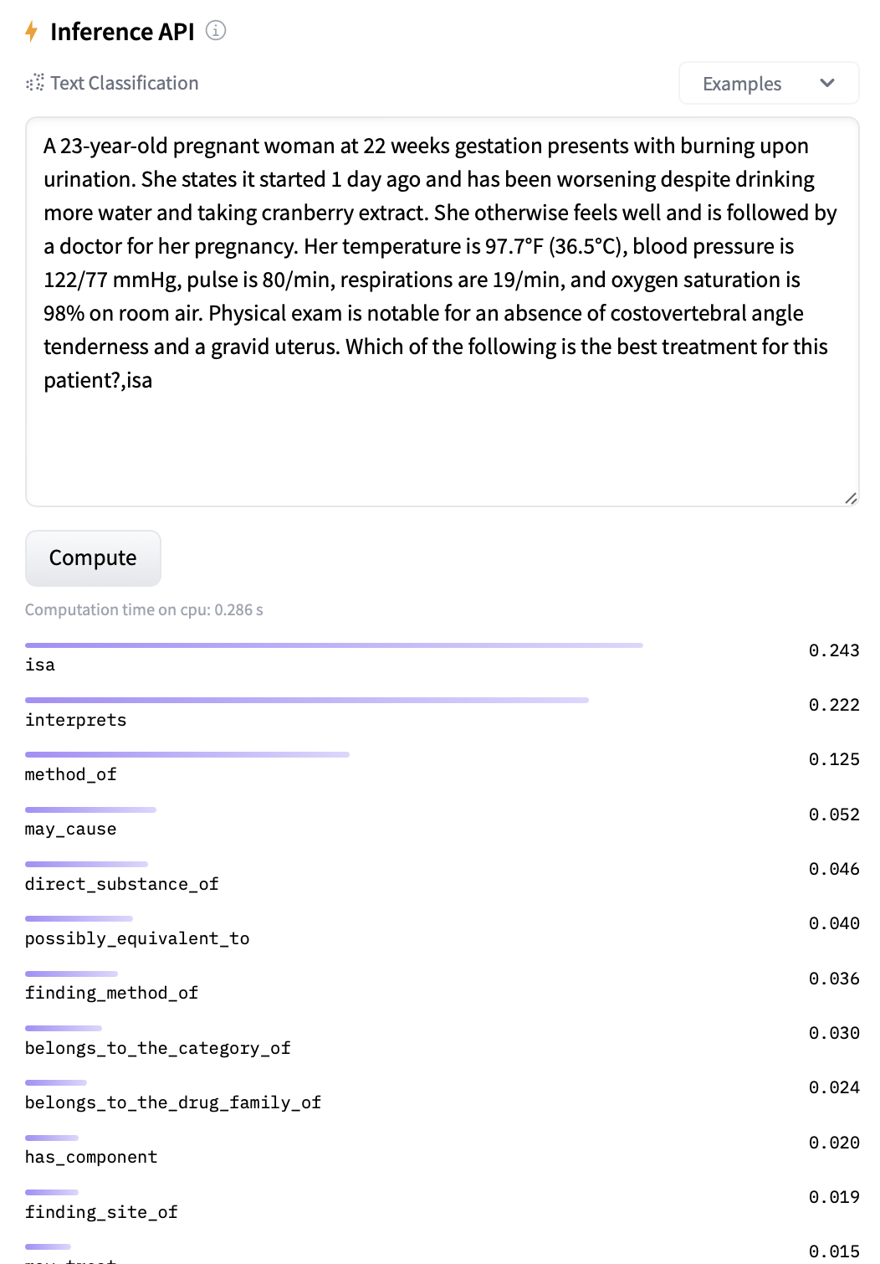
Next relation predictor
HuggingFace model available with ease!
How does the model behave?
Fine-tuned BioLinkBERT-base, a BERT-base encoder-only transformer with 108M parameters.
Learns which relation is the best to traverse to reach a potential answer entity:
If we are starting from a topic entity, the only input provided to the model is the MedQA question.
Once we traverse the graph, the input is augmented with new relations and the new relation is inferred.
In this way, we are disjoining the answer to two complex questions: where to proceed from how to proceed.
With the NRP task, we aim to answer effectively the second one.

Slide 14
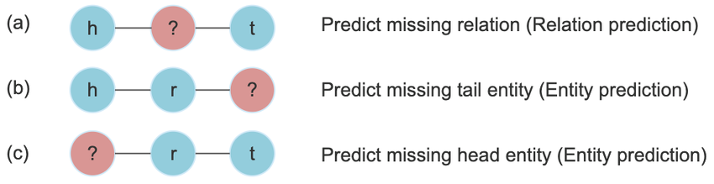
Link prediction
Given a direction, which node should we visit?
What’s next in the pipeline?
We should be able to predict the most probable tail given the head (current node) and a relation (point b in the left image).
I used PyKeen to train a dense graph embedding model using DistMult.
By default, DistMult uses the node numeric IDs to compute the embeddings:
We use PubMedBERT-matryoshka to compute a vector embedding that better represent the semantic meaning.
The matryoshka models let me create embeddings with just 128 dimensions, allowing for performance boosting during the PyKeen training procedure.

Slide 15
Term normalization
What happens when we are trying to use MedQA with UMLS?
High blood pressure
Matching terms on the KG
CODER model to perform term normalization.
In this way, whether we find a topic entity or an answer in the MedQA dataset that does not have a match in the UMLS KG, we find the most similar term in the graph:
each node in the UMLS KG is encoded and the whole result is dumped to the disk as a PyTorch Float Tensor (32-bit for maximizing accuracy);
when a text must be normalized in the graph, it’s encoded with CODER and compared against all the other ones by computing a cosine-similarity metric to get the k most similar nodes.
The first choice is kept and the other discarded, leading to one single node in the graph.
Hyperthension
HTN
C0020538

Slide 16
End-to-end model
Pipeline as a whole
Receive the input composed by the question text and each topic entity
Normalize the topic entities with CODER.
Traverse the graph, finding the paths with the NRP
Instantiate the paths with the LP
Merge the subgraphs
Architecture overview
TE₁
G₁
Term Norm
NRP
LP
<relation₁, relation₂, …, END>
TE₂
G₂
Term Norm
NRP
LP
Question
Final subgraph
Merge subgraphs
<relation₁, relation₂, …, END>
Keep common nodes
TE_{n}
G_{n}
Legend
NRP = next relation predictor
LP = link predictor
Te_{n} = topic entity n
G_{n} = subgraph induced starting
from topic entity n
Term Norm
NRP
LP
<relation₁, relation₂, …, END>

Slide 17
Code Overview

Slide 18
Tech stack
Which technologies I used
Docker for making the experiments and setups reproducible.
SLURM for accessing the cluster machine and attacched resourcers, GPUs for training and evalauting the models
HuggingFace as a repository for the models and dataset.
GitHub for storing code and medium-sized model/data artefacts.
PyTorch for creating the architectures and pack the models into defined structures to be portable and streamline HuggingFace-related processes, e.g. upload the models.
PyKeen for creating and evalauting dense graph embedding models.
NetworkX for create, manipulate and compute shortest path over graph data structures.
cuDF and cuGraph (CUDA 11 compatibles versions) for leveraging GPU computing capabilities to compute shortest paths, opening a GitHub issue.

Slide 19
Let’s look at the code!

Slide 20
Conclusions

Slide 21
What’s next?
Current limitations and possible solutions
Link predictor: PyKeen embedding model can be further fine-tuned to improve its performance.
Leverage neighbour's context to improve the vector representations of the nodes.
Train with a bigger version of matryoshka model
Use the entire UMLS KG.
Subgraphs merging:
For each of the nodes in the merged subgraph, consider adding all the neighbours' entities in the n graphs.
Keep nodes present in at least k of the n subgraphs. In this way, I maximize the recall, lowering the precision.
CODER poor performance: use modern vector database solutions – such as Qdrant – for performing the term normalization step more smoothly, improve its efficiency and performance.
Next relation predictor: there are several limitations mainly due to two facts:
The model has a limitation in terms of number of parameters (110M in BERT-base models). Using a BERT-large model (340M parameters) could improve the performance. Also, an LLM could be fine-tuned or even few-shot prompted.
The NRP dataset was built considering just one simple path for each question-answer pair. Thus, I’m missing both multiple paths and cycle graphs, potentially yielding to better results. As of now, I could use cuGraph capabilities to pursue this strategy.

Slide 22
Q&A

Slide 23
Thank you!

